Slide 1
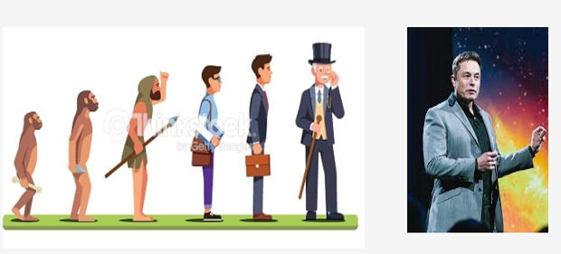
Where are we?

Slide 2

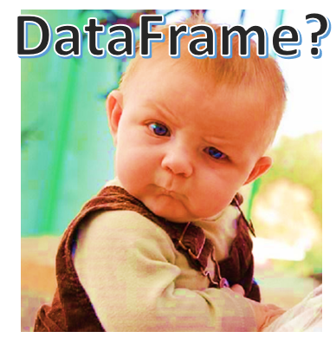
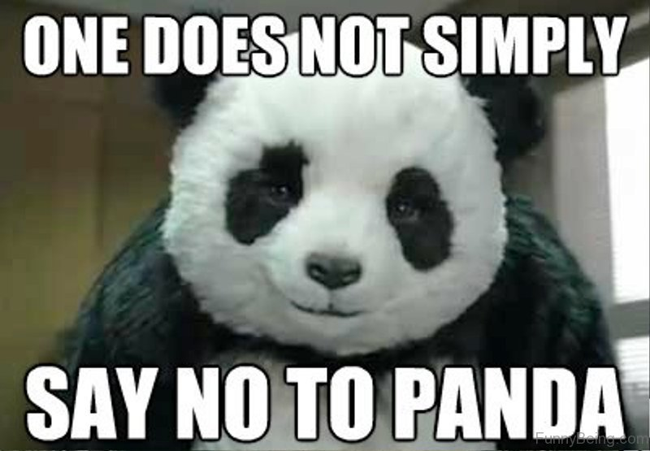
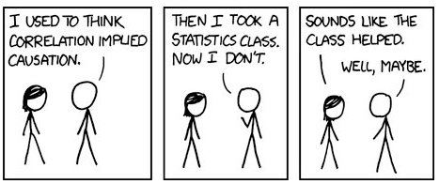
Recap Data Preprocessing, SVM and Decision Trees

Slide 3
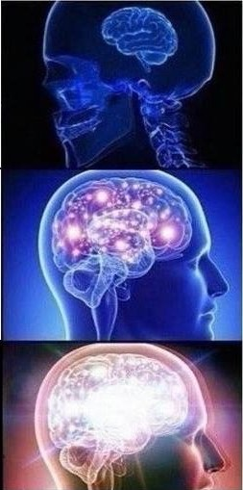
Know how to split data into training and testing datasets
Know how to carry out z-score and min-max normalization
Know how to create yummies, sorry, I mean, dummies

Slide 4
No one can bully me with buzz words anymore, I know what is a Support Vector Machine now
Know what does it means by maximizing my margin and the difference between soft and hard margin
I now live in higher dimension while others still live on lower dimension.
I can visualize and will always look for hyperplane to solve my daily problems

Slide 5
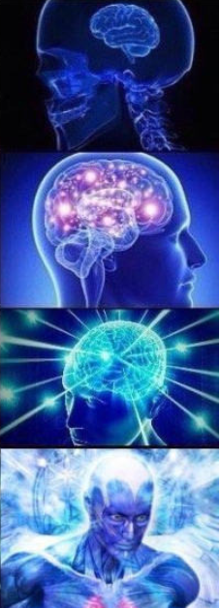
Know if else statements and how to divide and conquer
Know how to draw a decision tree to decide whether to bring an umbrella to school or not
Know not just
E = MC^2 , but also
H = - p * log p
Know how to calculate the
Gini index !!!

